Slide 1
Multi Org versus Single Org
Julien Guérin
Senior Manager, Customers For Life

Slide 2
Safe Harbor
Safe harbor statement under the Private Securities Litigation Reform Act of 1995: This presentation may contain forward-looking statements that involve risks, uncertainties, and assumptions. If any such uncertainties materialize or if any of the assumptions proves incorrect, the results of salesforce.com, inc. could differ materially from the results expressed or implied by the forward-looking statements we make. All statements other than statements of historical fact could be deemed forward-looking, including any projections of subscriber growth, earnings, revenues, or other financial items and any statements regarding strategies or plans of management for future operations, statements of belief, any statements concerning new, planned, or upgraded services or technology developments and customer contracts or use of our services.
The risks and uncertainties referred to above include – but are not limited to – risks associated with developing and delivering new functionality for our service, our new business model, our past operating losses, possible fluctuations in our operating results and rate of growth, interruptions or delays in our Web hosting, breach of our security measures, the immature market in which we operate, our relatively limited operating history, our ability to expand, retain, and motivate our employees and manage our growth, new releases of our service and successful customer deployment, our limited history reselling non-salesforce.com products, and utilization and selling to larger enterprise customers. Further information on potential factors that could affect the financial results of salesforce.com, inc. is included in our annual report on Form 10-K for the fiscal year ended January 31, 2010 and our other filings. These documents are available on the SEC Filings section of the Investor Information section of our Web site.
Any unreleased services or features referenced in this or other press releases or public statements are not currently available and may not be delivered on time or at all. Customers who purchase our services should make the purchase decisions based upon features that are currently available. Salesforce.com, inc. assumes no obligation and does not intend to update these forward-looking statements.

Slide 3
Agenda
Defining an Org Strategy
Considerations
Two Models
Standards, regardless of strategy
Why customers move to a Org
Proposed Methodology
Detailed discussion points
Deployment best practices
Summary

Slide 4
Defining an Org Strategy

Slide 5
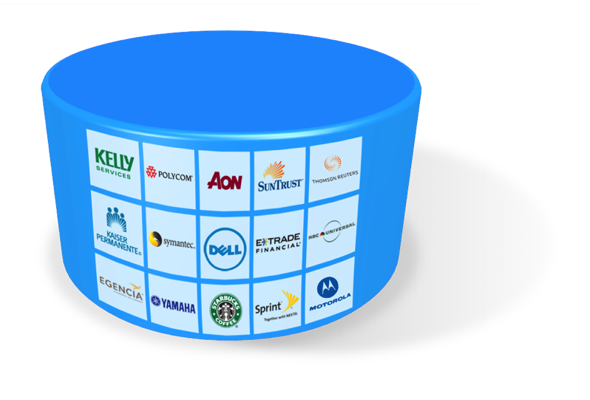


What is an Org?
Org 1
Org 2
Org n
Seamless Upgrades
No scaling / tuning
Shared Components
Data & Custom Metadata
Data & Custom Metadata
Data & Custom Metadata
One Version
Multi-Tenant Core
A logical Org of data and metadata for a set of users
Controls capacity limits and computing resources
Multiple environments in salesforce cloud is much easier (no costly stack to maintain)

Slide 6
What is an Org Strategy?
An Org Strategy is a plan of how to best use Salesforce with your business
It outlines the underlying Org architecture that will be used in your Salesforce solution
Single
Multi
SALES
SALES
REGION A
SALES
REGION B
OR

Slide 7
Why Do I Need an Org Strategy?
Identify how which business areas will be using Salesforce:
Data sharing
Business processes
Ownership
Identify technical requirements required to run your Salesforce solution
Ensure that the solution is setup in the most effective way for your companies needs

Slide 8
Org Strategy Considerations

Slide 9
Attributes to Consider
Corporate Initiatives
Change Management
Culture
IT Governance
IT Support
Maturity of Org(s)
The closer the alignment along these 3 domains, the better the fit for one Org
Organizational
Organizational
Go to market strategy
Customer Base
Products & Services
Alignment of processes
Level of standardization
BU Autonomy
Business
Business
Technical
Org Wide Limits
Warehouse Reporting
Security / Sharing Model
Workflow Rules
Data
Administration
Release Strategies
Technical

Slide 10
Organizational Considerations
Governance
Can a standards based strategy be adopted allowing easy consolidation in the future?
Culture
Can your organizational culture manage the governance and negotiations necessary to support the strategy?
Change management per country versus overall change management?
Corporate Strategy
Does your corporate strategy support a silo approach or global processes?
Are there financial or legal constraints that lead you down a specific path?
Change Management
Is your training departments regionalized?
Do you need to compensate for language?
Built for speed-to-market or methodical?

Slide 11
Business Considerations
Collaboration
Is there a need to share data between countries?
Is it planned to use chatter in the future across countries?
Reporting and Analytics
At what level is there an overall need for cross business roll­up reporting?
Overall country reporting necessary?
Process
Are the businesses and processes that will be sharing the Org fundamentally different?
Processes per country versus aligned processes.
Support Organization and Governance
Who are the owners of the businesses impacted?
Is one group able to move faster and more likely to change? (Time to Market)

Slide 12
Architectural Considerations
Capacity / Performance (Limits)
Data and Meta-Data Constraints
Limits
Overall peformance (Territory management, amount of data)
Common data/meta-data
Shared product development
Integrations
How many interfaces are involved?
One SAP PI for all countries or regional integration broker?
Latency
Scalability
How many Orgs will be required for the multi-Org scenario?
What development tools and products are being used?
Developing a deployment strategy for a multi-Org scenario?
Security and Sharing
Security is generally an Org-wide setting, so visibility and permissions can be difficult to manage.

Slide 13
Two Models

Slide 14
Single Org Model
Cross business unit collaboration
Salesforce Chatter
Aligned processes, reports, dashboards, security – consolidated customization
Ability to share data where appropriate
Alleviates need for data silos
Unified reporting
Single login to access multiple business functions
360 view from a central point of view – overall reports possible
Interfaces are easier to maintain and central org maintenance
reuse of configuration and code
(Person Account Functionality)
Benefits
All user detail information can be seen from any user
Owner change: A user can assign a new owner to another country
Email Relaying only possible with one email server.
Org complexity could become a barrier to progress
Potential to hit specific Org limits, such as number of custom tabs, objects and code lines
Org-wide settings (e.g. security , sharing and territory management) could become difficult to govern and manage
Run time processing could be impacted by volume of code deployed resulting in breaches of API and APEX governor limits
Data volumes are higher – performance optimization necessary?
Time to market and innovate could be impacted by number of teams rolling out new functionality
More teams updating shared configuration and code means more regression testing is needed as complexity increases over time
Fewer sandbox environments reduces testing capabilities
Local administration is difficult
Risks

Slide 15
Multi Org Approach
Email Relaying possible with different Email servers.
Logical Separation of data
Reduced risk of exceeding Org limits
Tabs, objects and code lines
Run time governor and API limits,etc
Org-wide settings are easier to govern and managed, e.g Roles, Sharing and Territory Mgmnt is easier to setup in one org
Simpler security model and sharing rules
Lower data volumes within a single Org - potentially improves performance
Improved time to market and freedom to innovate
Fewer teams impacted by shared updates
Reduced complexity within a single Org
More sandbox environments means more testing capabilities
Local administration and customization possible
Benefits
Monitoring of Integration Broker (SAP PI) is very difficult.
Different connections between SAP PI and Salesforce instances have to be established (technical user)
Harder to get a clear global definition of processes and data
Less reuse of configuration and code
Solutions for shared common business requirements need to be deployed to multiple Orgs
Inferior collaboration across business units
No cross Org Salesforce Chatter (if Chatter enabled)
Custom solutions required to deliver unified reporting across Orgs
Duplicated administration functions required
Increased complexity for single sign on
Overall Reporting only possible with introduction of “Master” Org
Merging/Splitting Orgs and changing integration points is very difficult.
Administration is extensive for configurations which cannot be deployed automated processes. (manual configurations)
Deployment strategy needed
Person Account Functionality is not supported if managed packages are considered
Risks

Slide 16



Multi-Org Example 1
Business
Vendors / Partners
SMB
SHS
Legal / Contracts
INTERNET
Business Org
Internal
Finance
HR
IT
Legal
Internal Communications
INTERNET
Internal Org
Consumer Org
INTERNET
Consumer
Marketing
Sales
Support

Slide 17
Multi-Org Example 2
LEGACY SYSTEM
Master
MASTER Org
Master data to be pushed to all linking Orgs, also integrated into legacy systems
Internal Org
Business Org
Consumer Org
INTERNET
INTERNET
INTERNET
Internal
Business
Consumer
Finance
HR
IT
Legal
Internal Communications
Vendors / Partners
SMB
SHS
Legal / Contracts
Marketing
Sales
Support

Slide 18
Multi-Org Example 3
LEGACY SYSTEMS
Template
Integration Broker
Child 2
Child 3
Child 1
INTERNET
LL
LL
Local Legacy

Slide 19
Standards, regardless of strategy

Slide 20
Regardless of Strategy – Standards are necessary
Architecture standards
Naming standards
When to use record types, page layouts, etc.
Security & record sharing model
Reporting & Dashboard templates
Integration standards
Testing standards
Training standards
Data Quality standards
Release management
CoE participation

Slide 21

A Common Standards Approach
Child Orgs
BU Org 2
CoE Governance
Standards documents applied to all Orgs
BU Org 3
Customizations at the child level
OR
BU Org 4
HQ / Org 1
Packages
Other
Parent Org and/or
Reporting Org
Base Set of Code & Configuration
Child Org Specific Customizations

Slide 22
Why customers move to a Org

Slide 23
Why Customers Move to a Single Org
Greater Management Visibility
Roll-Up Reporting
Global drill-down into pipeline & activities
Collaboration
Know what everyone everywhere is doing
Increase Upsell & Cross-Sell Productivity
Avoid duplicate effort & conflicts within accounts
Centralization and Standardization
Utilization of Existing Centralized Application Administration & Change Control
Integration Infrastructure
Managing Data Cleanliness
BU Personalized Configuration Capability
Granular security model, multiple profiles, records types, page layouts, sharing groups
Translation Workbench

Slide 24
Why Multiple Orgs?
“Unlimited” Personalization
Each region can do what they want with no global constraints (if a template approach is not used!)
Lower likelihood of reaching configuration limitations
Simplified Configuration
Minimize org complexity e.g. sharing rules, territory management, record types, etc.
Localized Change Management
Local admin team can be more responsive to local users
Flexibility
Adoption of new features that are all or nothing (ie Territories)

Slide 25
Proposed Methodology

Slide 26


Proposed Methodology
Data
Collection
Base Line/
Scoring
Affinity Matrices
Consolidation
Recommendations
Template
Creation
Inputs
Organizational,
Business,
Technical
Base Line /
Score
Organizational,
Business,
Technical
Compare /
Affinity
Organizational.
Business,
Technical
Decision Criteria /
Determine Orgs
Organizational
Business
Technical
Define Knock Out criteria:
Timezones / Local
Support
Legal restrictions
Limits
Resources
(independent from
Org-decision)
Define
“On-Boarding”
Template(s)
Organizational,
Business,
Technical
The first step in the study consisted of understanding the Organizational, business and technical use of SFDC for existing business units.
After inputs were gathered, the study focused on creating a profile of the business units both functional and technical
The study then focused on identifying similarity between each business units
The last step involved creating the definition and process around on boarding

Slide 27
Detailed Discussion Points

Slide 28

Reporting & Dashboards
Single Org
Complete roll-up reporting available for all countries.
Multi Org
Reports would be limited to summarizing data on a single org / country at a time.
Solution option – Create or use an existing data warehouse that replicated all customer records into a single database providing the complete view of the customer.

Slide 29

Administration - Visibility
Single Org
Administrators can view customization relating to other groups.
Potential exists for changing another business’ configuration.
Multi Org
Administrators can only see customizations relating to their own org
Scope of changes they can make is tied to their own (country) business.

Slide 30
Administration - Impact
Many configuration settings have an org wide impact. For example: Tab name, Field names, forecast settings, product grouping, territory mgmt, Chatter, etc
Single Org
All businesses would be affected by any changes with an org-wide scope.
Multi Org
Multiple orgs allows each business flexibility to choose their own org wide settings

Slide 31

Large Data Volumes
Single Org
Requires additional data management design considerations including the use of divisions (logical data partitions), data tiers (current/history tables), and performance testing cycles to ensure good application performance.
Multi Org
Data is spread out across multiple orgs and additional design considerations are less intensive.

Slide 32

Email Relaying
Single Org
Email Relaying can only be set up for one email server per org. More than one email servers for different countries cannot be set up.
Multi Org
Email Relaying can only be set up for one email server per org/country. Each country can use a dedicated email server.

Slide 33

Single Sign On Settings
Single Org
Single Sign On configuration only possible per org. SSO configuration per country is not possible.
Multi Org
Single Sign On configuration only possible per org. SSO configuration per country is possible.
Different SSO configurations are harder to maintain on client site.

Slide 34

Interfaces - Middleware
Single Org
One middleware is connected to one org (one technical user).
Interface logic on middleware is easier to maintain for one org. (Routing of messages, Aggregation, Multiplexing, Transformation, Enrichment of data)
Multi Org
One middleware is connected to n orgs (n technical user) OR n middleware instances are connected to one org.
Interface logic on middleware is harder to maintain for different orgs. (Routing of messages, Aggregation, Multiplexing, Transformation, Enrichment of data)
One SAP PI instance for all countries?
How to integrate countries without SAP backend?

Slide 35

APEX code considerations
Single Org
APEX code has to cover all requirements from all countries/functional areas.
Less flexibility
Harder for local customizations / implementations
Limits will be reached faster
Multi Org
Dedicated APEX code per country could be implemented.
Template approach needed if code base should be the same.
More flexibility
Local customizations / implementations possible
Limits will be reached slower

Slide 36
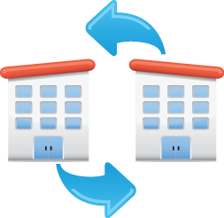
Deployment
Single Org
Release management is easier to set up.
One code base which reflects all functional areas / countries.
Deployment could be done with semi automatic procedures (Eclipse).
Multi Org
Release management is harder to set up.
Template approach needed?
ANT tasks to deploy code base automatically to n orgs.
Manual steps are still required per org.
Deployment of n orgs takes longer than deployment to one org.

Slide 37

User Visibility and Owner Assignment
Single Org
All active users are visible when assigning or delegating records from one user to another
User and user-details from other countries can be seen by other users.
Logical separation needed.
Every user in the org can be used as a new record owner. → User from another country could be assigned.
Multi Org
Users are separated per org.
User and user-details from other countries cannot be seen by other users.
Physical separation.
New record owners only per country.

Slide 38


Salesforce Limits
Single Org
Limits will be reached faster.
Multi Org
Dedicated Limits per org – limits are reached slower.
A detailed analysis of these limits needs to be performed in order to find the right org strategy.

Slide 39
Salesforce Limits – Detailed Analysis
Number of sharing rules per entity (criteria based sharing + sharing rules): 300
Number of criteria based sharing rules: 50
Maximum number of workflow rules per entity: 50
Maximum number of Api Batch Items (per day): 2000
Maximum number of dynamic dashboards: 10
Multi Select Picklist Values: 150 per licence
...
Further documentation:
APEX Governor Limits
Salesforce.com Limits

Slide 40
Timezone Consideration
Single Org
APEX Batch jobs are running at night. Hard to call APEX Batch jobs in a 24/7 environment.
All users are working on a eu-server.
Multi Org
APEX Batch jobs can run at night.
All users are working on an appropriate server.

Slide 41
Actual recommendation
Recommendation
Consideration | Single Org | Multi Org
Administration: Visibility Context: Ability for administrators to work autonomously
Administration: Impact Context: Org wide setting management
Administration: AppExchange Context: Cost of licenses and deployment effort, e.g. Snapshot
Administration: Change Management Context: Configuration of common data fields from departments
Data Volumes/Integration Context: Sustaining an efficient and well-architected infrastructure
Reporting and Dashboards Context: Holistic reporting on the customer
Deployment Context: Agile development
Security Context: Managing security
Customer 360 view Context: A total view of your customer
New Arguments t.b.d.
?
?
?
?
?
?
?
?
?
?
?
?
?
?
?
?
?
?
?
?

Slide 42
Knock Out Criteria?
Email Relaying?
Interfaces will get complicated?
Org Merges?
Reporting?
Security, Sharing, Territory Management?
Legal Constraints?
Single Sign On?
Limits?
tbd...

Slide 43
Deployment Best Practices

Slide 44
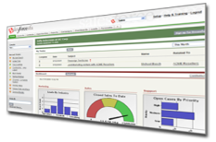
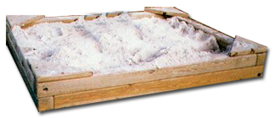
Establish Process and Governance
Multi Org Release Management
Migration from sandbox to production
Use of configuration only sandboxes for developer workspaces
Migration between sandboxes
Partial data copy
Production
UAT/ Staging
Integration
Development
Notes:
44

Slide 45
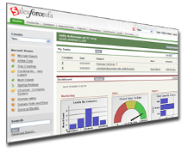
Establish Process and Governance
Version Control
Prodution
Staging
Development
Integration

Slide 46
Establish Process and Governance
Best Practices
Remember that salesforce.com already provides a hosting environment for code
Reduces code loss risks as opposed to an on-premise development environment
Provision users to the environments appropriately
Only provision users who participate in development processes
Enforce authorization using access levels
Create and Configure Profiles that defines appropriate access levels to code and configurations
Create a Roles Responsibilities Matrix to delegate tasks and enforce accountability

Slide 47

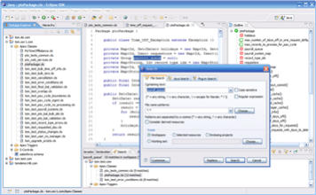
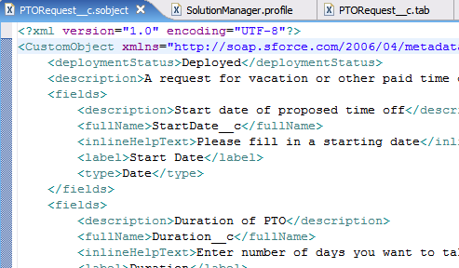
Leverage and Configure Tools appropriately
Leverage Tools that can aid the development process
Salesforce Tools and Framework
Force.com IDE (Eclipse based)
Force.com Migration Tool
Change Sets (Cloud Deploy)
Managed Packages
Apex Test Framework
Customer Tools
Version Control
Change Management
Development
Tools
Test
Dev
Project Branch
Dev
Version Control

Slide 48
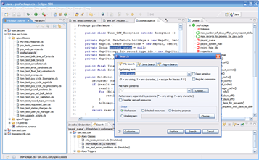
Leverage and Configure Tools appropriately
Force.com IDE
Development tool for authoring Apex and VF code
Retrieve & deploy changes between orgs
Integration with Eclipse-based version control systems
Analysis tools like visual compare
Debugging
Test infrastructure
feature
regression
UI test
Modern editors for all metadata types (Code, UI, XML)
Sandbox orgs for dev workspaces and integration testing
Extension APIs for 3rd party tool extensions
visual editors
model-driven development
Notes:
48

Slide 49
Leverage and Configure Tools appropriately
Force.com Migration Tool
Retrieve & deploy changes between orgs
There are 3 main ways to take advantage of the meta data API to impact your organization’s metadata
Force.com IDE: An integrated development environment based upon the eclipse toolkit
ANT Tasks: A command-line-based tool built on top of the ANT framework
Custom Tools & Applications: 3rd party applications that have been built on top of the APIs noted above (Snapshot)
Metadata API
Easy Access to Code
and Schema
Notes:
49

Slide 50
Leverage and Configure Tools appropriately
Managed Packages
Intended for ISV
Collection of code assets that deliver a set of functionality
Supports development of concurrent releases
Create a package that has changes per feature
Must include all code assets that are changed
Have proper naming conventions for the package
Provide appropriate package that has the release components
Code assets can be named the same such that when the managed package is installed they override the existing code asset
Notes:
50

Slide 51
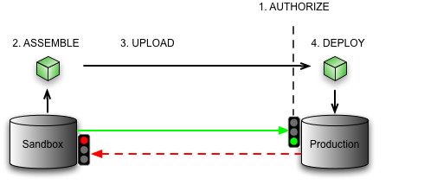
Leverage and Configure Tools appropriately
Change Sets
A quick deploy tool to deploy configuration and code from a Sandbox to Production
Incorporates spidering that determines code and configuration dependencies
Aimed for organizations whose admins are less knowledgeable with Eclipse, ANT
Only useful for migration from a Sandbox to Production
Following is a set of tasks to be done to utilize this feature:
Authorize a connected organization (sandbox/production) to upload changes to this organization.
Assemble a set of metadata components and upload to a connected organization.
Deploy a Change Set uploaded to this organization so that its contents are applied and the changes are available to end users.
Not supported for Developer orgs
Disconnected process where developers upload changes and QA/ Release Managers download and apply changes
Notes:
51

Slide 52


Leverage and Configure Tools appropriately: When to use what Force.com Migration Tool?
NEED | Force.com IDE | ANT based Migration Tool | Change Sets
Configuration Changes (Add/ Update)
Code Changes (Add/ Update)
Deleting Configurations and Code assets
Nightly Automated pushes – batch releases
Less Programming/ ANT / IDE Skills
Automated Test Coverages
MED
MED
HIGH++
HIGH++
Notes:
52

Slide 53
Leverage and Configure Tools appropriately
Not all changes can be propagated using Migration Tools
Salesforce is designed for end users to make some configuration changes. Some of these changes can be made in production and shared when the testing is complete:
These changes are still tested before being shared with end users. This is done through access controls!
Please check the latest documentation on what types are supported and not supported
Adding a new user
Creating a “message of the day”
Group Membership
Creating a territory
…

Slide 54
Leverage and Configure Tools appropriately
Best Practices
Use latest versions of tools
Enforce standard versions of Eclipse IDE across development
Reduces risks of unavailable API
Provide documentation to teams
Create a Dependency Matrix for deployments
Dependency Matrix describes and provides a step by step guide to deployment
For effective Release Management, use Package.xml (with appropriate set of assets) as a mechanism to deploy components from one org to another
Version control this package.xml to preserve audit of what was pushed

Slide 55
Development Practices
Best Practices
Enforce policy to sync code periodically with version control and SF org
Adherence to coding standards and best practices
Periodic code reviews
Develop test classes and enforce higher test coverages

Slide 56
Summary

Slide 57
Summary
There is not right or wrong answer on org strategy but rather a set of guidelines that can be evaluated
There are benefits and implications to either approach that that need to be applied to your specific organization
Decision needs to be validated by key stakeholders and agreed upon

